Slide 1

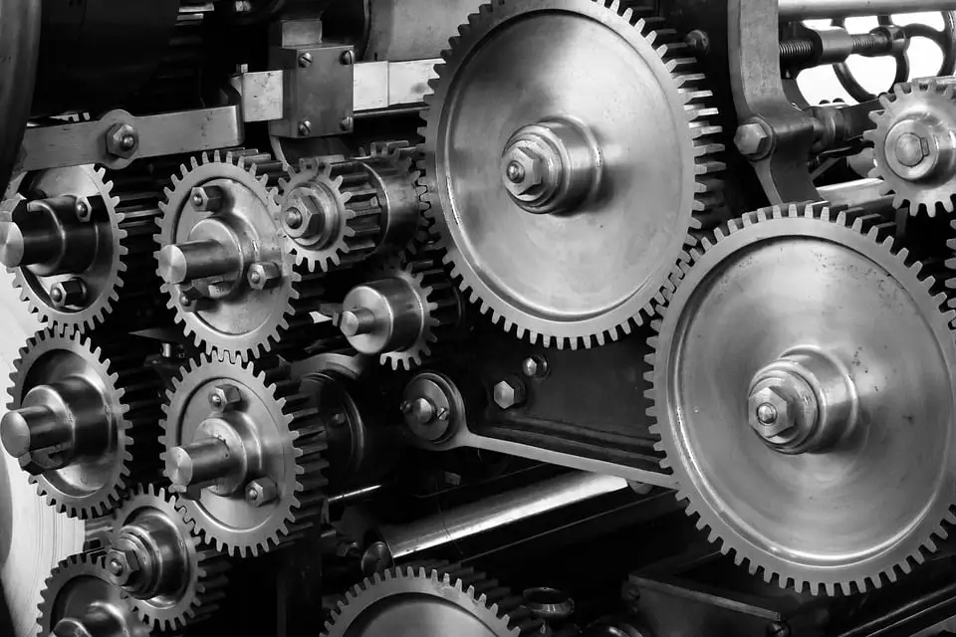
Analytics Software I
Group Project
Machine Failure Prediction
Names: Goel Ishita, Zhao Jiayi, Khoo Chun Yun, Ang Shu Wei, Yu Qing

Slide 2
TABLE OF CONTENTS
01
02
Data Description
Introduction
03
04
Methodology
Evaluation Metrics
05
06
Results
Conclusion & Future Work

Slide 3
Introduction
Nowadays, machine failure is a common phenomenon. Modern machines are complicated pieces made with thousands of individual parts.
Predicting machine failure can help prevent unplanned and costly machine failures of paramount importance.
With the development of technology, the condition of the machinery can be tracked. This information can then be further utilized to predict whether the machine is in working condition or not, enabling proactive maintenance and minimizing downtime.

Slide 4
Introduction
For this project we will use The Machine Failure Predictions Dataset from Kaggle[1] which contains observations of vehicles with their sensor data indicating the status of the machinery/vehicle.
The goal of this project is to develop classification/prediction models that can forecast machine failure based on the sensor readings. By utilizing machine learning techniques the aim is to provide early warning of impending machine failure allowing timely repair and/or replacements.

Slide 5
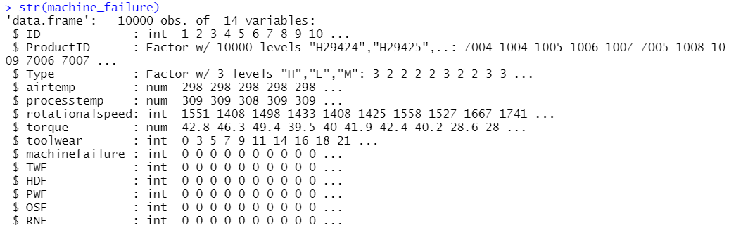
Introduction
The Machine Failure Dataset contains 10,000 observations, with 14 variables
The target variable is machinefailure which indicates whether the machine has failed or not.
From the initial analysis the data has no missing values.
The target variable and predictor ‘Type’ are converted to factors as an initial preprocessing step.

Slide 6
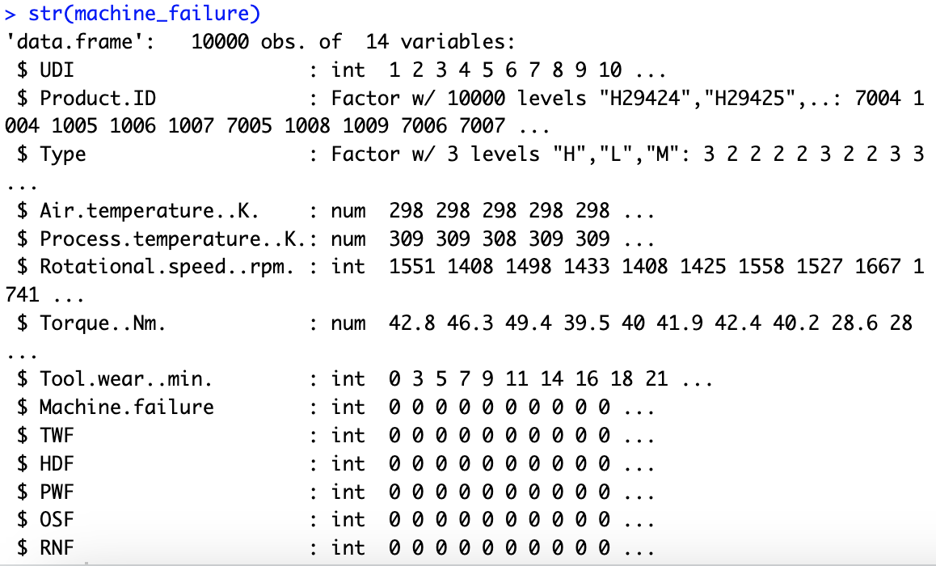
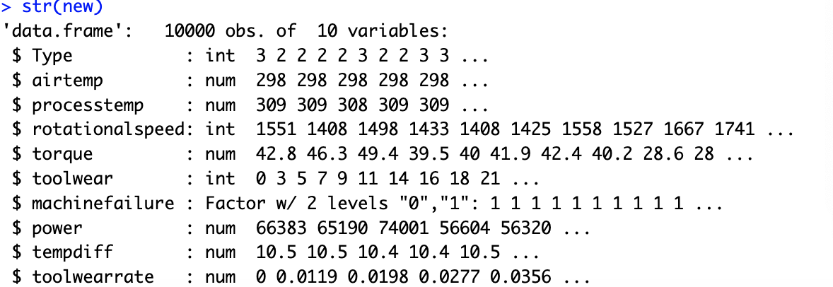
Data Description
Predictors: airtemp, type, torque, rotational speed, processtemp, toolwear
Target: machinefailure
Redundant Info: types of machine failure (TWF, etc.)
Additional Predictors of “Final” Model: power, tempdiff, toolwearrate

Slide 7
Data Description
The TWF, HDF, etc. are different types of machine failure.
As we noticed earlier, the five variables (RWF, TWF, etc.) aligned with target since they indicate the certain failure of certain part of the machine.
These values just categorize machine failure as one of the types of machine failure e.g. heat failure, temperature failure.
Hence, we remove the above-mentioned variables since they are redundant.

Slide 8
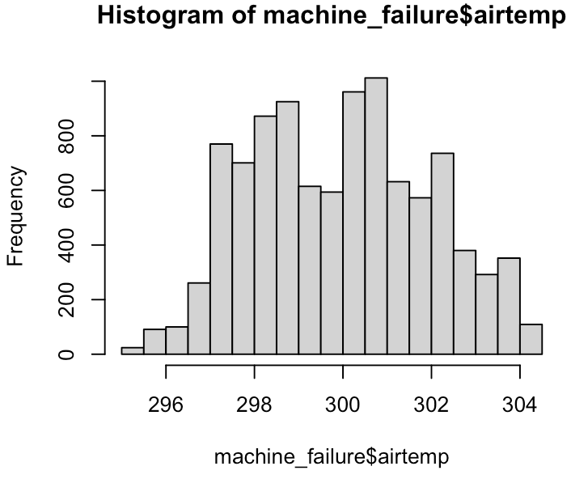
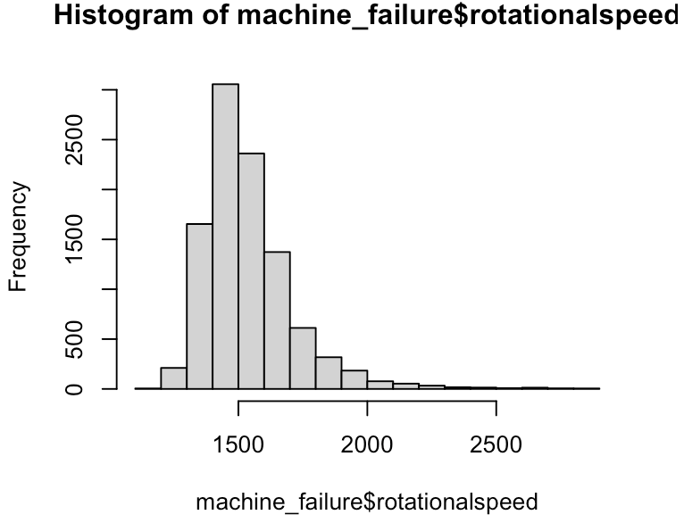
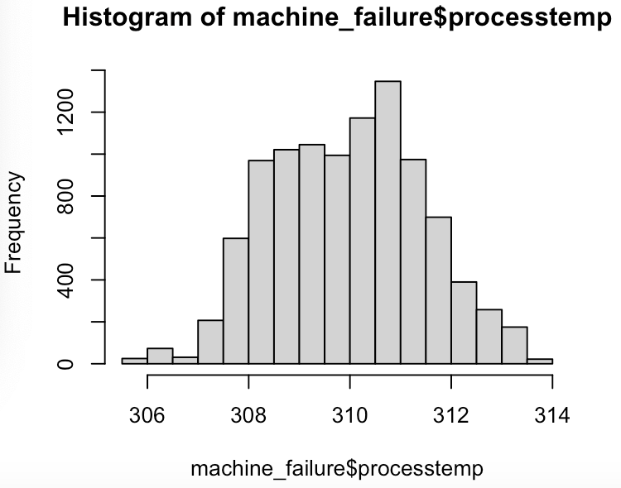
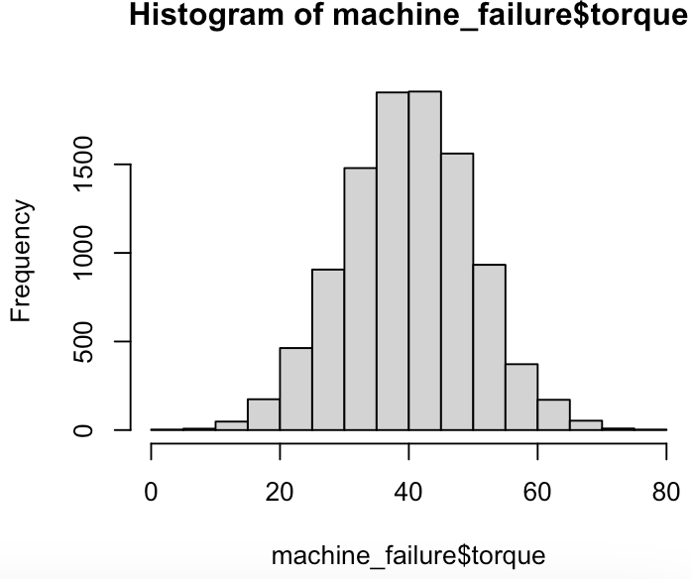
Data Description
Most predictors roughly follow normal distribution.
Mostly preserve the validity of certain statistical tests.

Slide 9
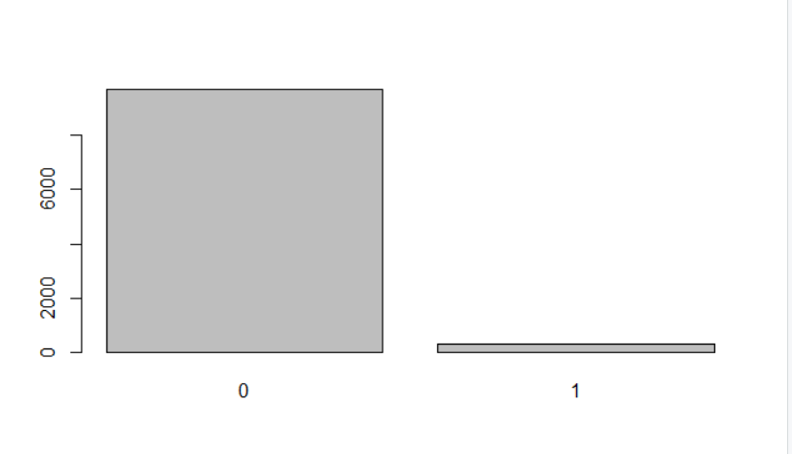
Data Description
The dataset is severely imbalanced towards the negative value
(0-no machine failure) as can be observed from the figure.
Hence, we use appropriate evaluation metrics to evaluate our model.

Slide 10
Feature Engineering
New features:
Tool wear rate:
by dividing tool wear (in minutes) by the maximum tool wear.
Power:
Approximated by torque*rotational speed
Temperature difference between process and air temperature
Intuition:
wear & tear is a common cause of machine failure
amount of power the machine is consuming could be indicative of whether it is malfunctioning
Too cold or hot environments may cause machines to fail, since they likely operate within a certain temperature range
Notes:
We also tried to engineer features to improve the performance of our machine learning models.
Specifically, we tried to use what we know from domain knowledge to create better quality features.
We came up with 3 features:
We decided to add tool wear rate, approximated by diving tool wear/maximum tool wear, as we recognise that wear & tear is a common cause of machine failure.
We also intuited the use of power, as we know intuitively that if the machine is using too high amounts of power to operate, it could indicate malfunctioning.
We also came up with temperature difference, as we know intuitively that machines work at a optimum range of temperatures, and if the air temperature is too hot or cold, it may cause the machine to fail. So temp diff captures that.

Slide 11
Methodology
Upsampling
Upsampling
Pre-
processing
Baseline
Model
Feature engineering
‘Final’
Model
Evaluation
SVM,
Decision Tree,
Random Forest
Logistic regression
Addition of:
Tool wear rate
Power
Temperature difference
Metrics:
Precision
Recall
F1
AUC
Notes:
Now we will run you through the methodology.
Firstly, we preprocessed the data as explained by jiayi earlier.
Next, given that this is a binary classification task, we will employ 4 classification models (SVM, logistic regression, Decision Tree,Random Forest) on the data using all the predictors, Air temperature [K], Process temperature [K], Rotational speed [rpm], Torque [Nm], Tool wear [min]
When training the model, due to the highly imbalanced dataset towards the majority class, we decided to use Upsampling, which is is a procedure where synthetically generated data points (corresponding to minority class) are injected into the dataset.
We considered but ended up not using downsampling as we would have to remove a large amount of observations, and thus potentially lose a lot of valuable information.
After which we performed feature engineering to try to improve the performance of the model as explained earlier. we added 3 more features, tool wear rate, power, temperature difference.This will make up our final model, which we also performed upsampling on the training data.
Lastly, we evaluated using these 4 metrics, which my groupmate will elaborate more on later.

Slide 12
Evaluation Metrics
Accuracy
Precision
Recall
F1-Score
AUC
Notes:
Besides looking at accuracy,
since this is an imbalance set it is also important to look at other metrics with respect to the positive class

Slide 13
Results

Slide 14
Logistic Regression

Slide 15
Logistics Regression
Models | Accuracy | Precision | Recall | F1 | AUC
‘Baseline’ model: TWF, HDF, PWF, OSF, RNF removed | 0.968 | 0.759 | 0.196 | 0.312 | 0.597
‘Baseline’ model Upsampling | 0.823 | 0.153 | 0.821 | 0.257 | 0.822
‘Final’ model: added new features power, temp difference, tool wear rate | 0.969 | 0.737 | 0.250 | 0.373 | 0.623
‘Final’ model Upsampling | 0.856 | 0.186 | 0.848 | 0.305 | 0.852

Slide 16
Decision Tree

Slide 17
Decision Tree
Models | Accuracy | Precision | Recall | F1 | AUC
‘Baseline’ model: TWF, HDF, PWF, OSF, RNF removed + boosting | 0.979 | 0.8333 | 0.536 | 0.652 | 0.766
‘Baseline’ model Upsampling + boosting | 0.977 | 0.712 | 0.661 | 0.685 | 0.825
‘Final’ model: added new features power, temp difference, tool wear rate | 0.985 | 0.860 | 0.714 | 0.780 | 0.855
‘Final’ model Upsampling + boosting | 0.983 | 0.794 | 0.723 | 0.757 | 0.858

Slide 18
Random Forest

Slide 19
Random Forest
Models | Accuracy | Precision | Recall | F1 | AUC
‘Baseline’ model: TWF, HDF, PWF, OSF, RNF removed | 0.980 | 0.894 | 0.527 | 0.663 | 0.762
‘Baseline’ model Upsampling & CV, tuning of mtry | 0.978 | 0.800 | 0.536 | 0.642 | 0.765
‘Final’ model: added new features power, temp difference, tool wear rate | 0.988 | 0.904 | 0.759 | 0.825 | 0.878
‘Final’ model Upsampling & CV, tuning of mtry | 0.985 | 0.914 | 0.661 | 0.767 | 0.8291

Slide 20
Support Vector Machine
(SVM)

Slide 21
SVM
Models | Accuracy | Precision | Recall | F1 | AUC
‘Baseline’ model Upsampling | 0.830 | 0.157 | 0.813 | 0.263 | 0.822
‘Baseline’ model Upsampling with kernel radial | 0.907 | 0.264 | 0.830 | 0.401 | 0.870
‘Final’ model Upsampling | 0.860 | 0.192 | 0.857 | 0.314 | 0.859
‘Final’ model Upsampling with kernel radial | 0.919 | 0.301 | 0.884 | 0.449 | 0.902

Slide 22
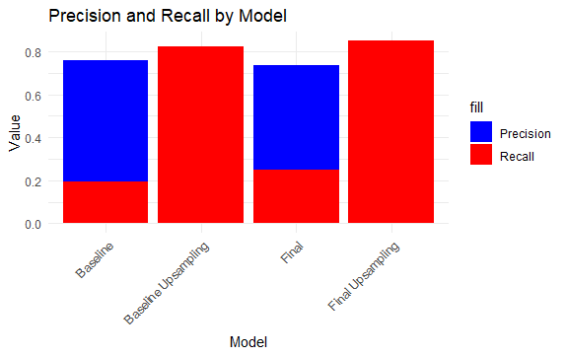
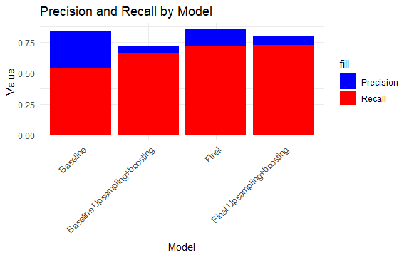
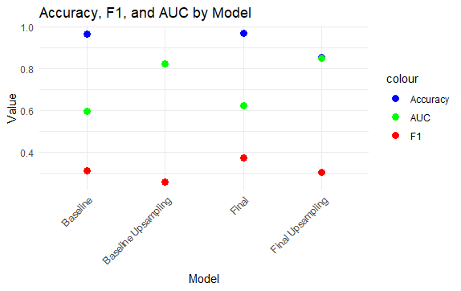
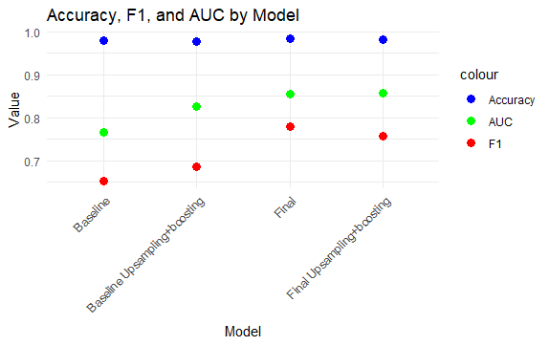
Logistics Regression
Decision Tree

Slide 23
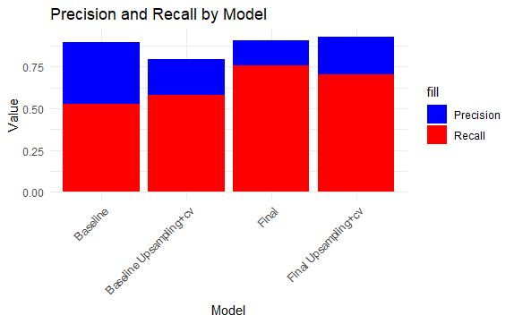
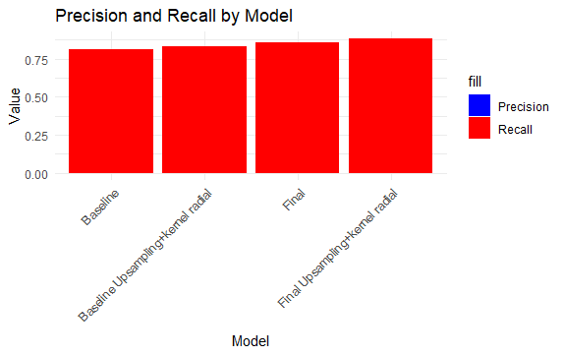
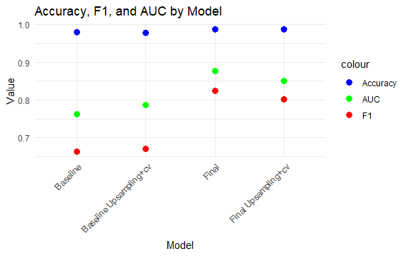
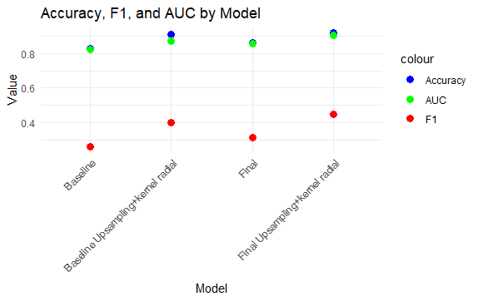
Random Forest
SVM

Slide 24
Conclusion
Feature engineering improved model performance.
In this case, F1 score is a good metric for evaluating model performance, especially suitable for imbalanced binary classification problems:
It comprehensively considers the precision and recall of the model, allowing us to assess the model's balanced performance in predicting positive and negative classes.
The model with the best performance is Random Forest.

Slide 25
Future Works
We initially choose Naive Bayes as well, but it performs badly because the categorizing process is arbitrary. We could improve the performance with an extension in Naive Bayes using OWA estimator.
We come across slight collinearity after feature engineering. To deal with this problem, we may try Regularization methods such as Ridge Regression and Lasso Regression.
There is potential for deeper analysis in terms of predicting the types of machine failure. This can facilitate not only timely, but also targeted repair and replacements as well.
The kaggle competition uses a dataset which was generated from a deep learning model. Feature distributions are close to, but not exactly the same, as the original. We may explore differences as well as to see whether incorporating the new in training improves model performance. [2]

Slide 26
THANK YOU

Slide 27
References
[1]Machine Failure Prediction Dataset
https://www.kaggle.com/datasets/dineshmanikanta/machine-failure-predictions
[2] Walter Reade, Ashley Chow. (2023). Binary Classification of Machine Failures. Kaggle. https://kaggle.com/competitions/playground-series-s3e17

